Slide 1
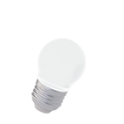
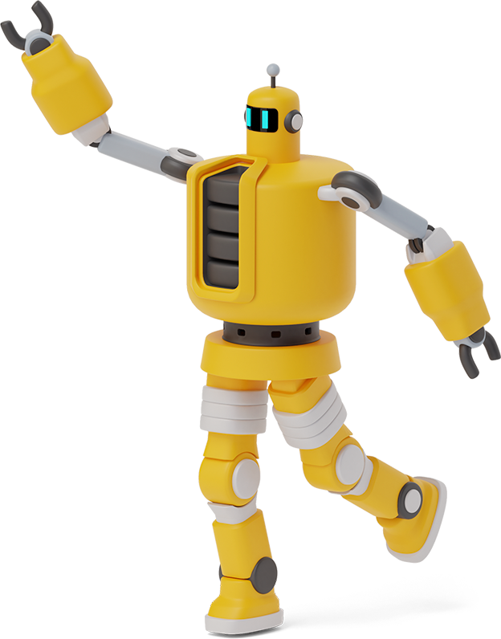
IIoT comes to ThunderVolt Michael Mohle Associate Director of Communications Thundervolt

Slide 2
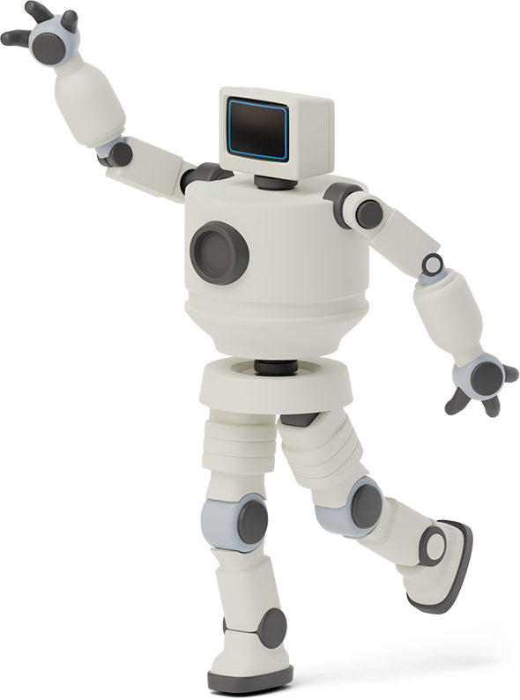

Hello!
Today we are going be talking about our companies embrace of IIoT as we transition to ThunderVolt, our agenda is as follows:
What is IoT/IIoT?
How IIoT will be game changer for ThunderVolt?
What implementing IIoT entails?
An example of IIoT in action
How implementing IIoT will allow ThunderVolt to become part of the big data / AI revolution.

Slide 3

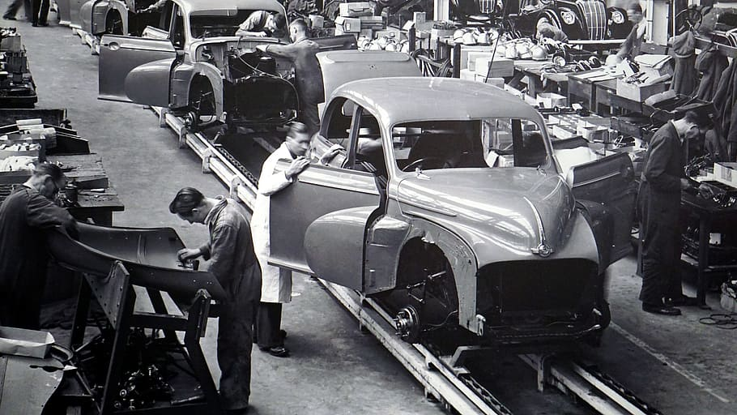
AS we go from the past>>>

Slide 4
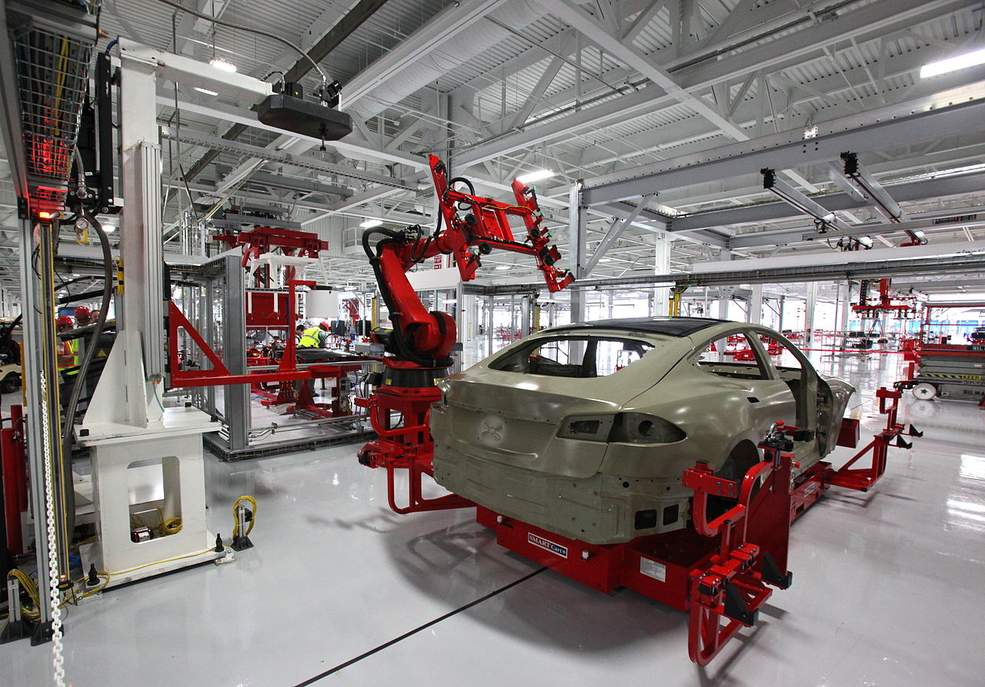
>>>To the future

Slide 5

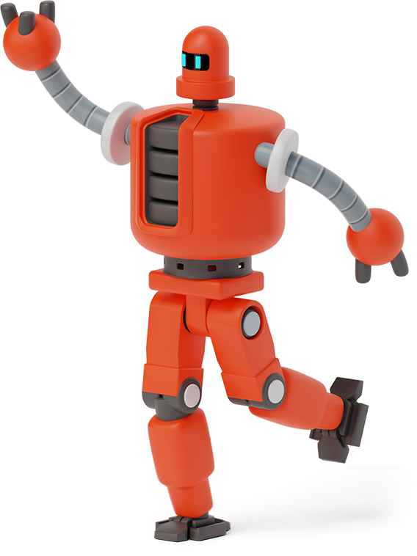
What is IOT/IIoT?
1
The Internet of Things(IoT), connects devices to the internet for data exchange and automation.
The Industrial Internet of Things (IIoT) in auto manufacturing connects machines and systems to improve operational efficiency, productivity, and decision-making.

Slide 6
Why is IIoT a game changer for ThunderVolt? (1)
2
IIoT is a game changer for ThunderVolt:
Enables real-time monitoring,
Enhanced predictive maintenance,
Data-driven optimization,
Leading to enhanced operational efficiency, reduced downtime, and improved decision-making for smarter and sustainable manufacturing.

Slide 7
Why is IIoT a game changer for ThunderVolt? (2)
2
With IIoT, ThunderVolt achieves improved product quality by leveraging real-time data analytics and predictive insights, while simultaneously reducing costs through optimized resource allocation, streamlined processes, and proactive maintenance strategies.

Slide 8
What implementing IIoT entails
3
Connecting machinery, devices, and sensors for data collection and communication.
Utilizing real-time data analytics and machine learning algorithms for actionable insights.
Enabling remote monitoring, predictive maintenance, and process optimization for improved productivity, efficiency, and decision-making.

Slide 9
An example of IIoT in action
In an IIoT implementation, diverse types of sensors, such as temperature, pressure, and vibration sensors, are embedded in manufacturing equipment. These sensors collect real-time data, which is then analyzed to predict maintenance needs, minimize downtime, reduce costs, and optimize efficiency and profitability in the manufacturing process.
4

Slide 10
implementing IIoT will allow ThunderVolt to become part of the big data / AI revolution.
5
Generating vast amounts of data through connected devices and sensors.
Leveraging AI and machine learning algorithms to extract valuable insights from the data.
Making data-driven decisions, optimizing operations, and driving innovation for competitive advantage in the EV market.

Slide 11

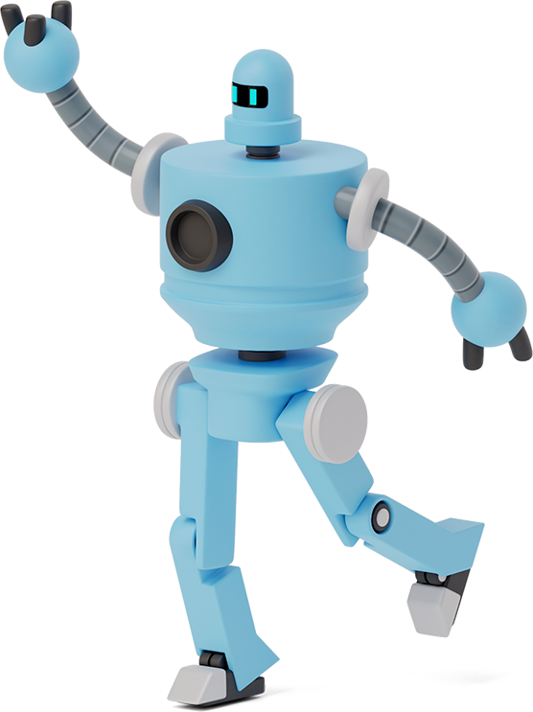
Summary
IIoT is a big win for ThunderVolt! By embracing connected devices, real-time data analytics, and AI, ThunderVolt gains a competitive edge. Proactive maintenance, optimized operations, and data-driven decisions propel them towards success, innovation, and a sustainable future in the dynamic world of industrial manufacturing.

Slide 12
Thanks!
Any questions? You can find me at:
Michael.mohle@Thundrvolt.com
317-666-6666
Third floor coffee shop!

Slide 13
Credits
Presentation template by SlidesCarnival
Photo Credits
https://www.pxfuel.com/en/free-photo-oxjnu (old style manufacturing)
https://commons.wikimedia.org/wiki/File:Tesla_auto_bots.jpg (new style manufacturing)

Slide 14
References
IIO Industry IoT Consortium, The Industry IoT Consortium is a global not-for-profit partnership of industry, government, and academia. https://www.iiconsortium.org/
iotforall. Iot for all is a website focusing on IOT technologies. This link is specific to the cloud/big data aspects of IIoT ( this source uses IIoT and IoT interchangeably). https://www.iotforall.com/aws-iot-platform-benefits.
IBM. IBM is a global technology provider. This source is specific to IIoT in auto manufacturing, https://www.ibm.com/downloads/cas/QXR3DG5O .

